Slide 1
Network Intrusion Detection
Anomalous
Radhey Shyam, Joseph Wang, Wanda Wang, Ho Fai Wong
June 26, 2016

Slide 3
Introduction
Task:
Build a predictive model capable of distinguishing between benign and malicious network connections (i.e. network attacks)
Balance model accuracy with interpretability and resource consumption
Background:
MIT’s Lincoln Laboratory set up an environment to acquire nine weeks of raw TCP dump data for a local-area network (LAN) simulating a typical U.S. Air Force LAN
They operated the LAN as if it were a true Air Force environment, but peppered it with attacks falling into four main categories:
DOS: Denial of Service
R2L: Remote to Local
U2R: User to Root
Probing: Surveillance
The data used for this analysis was provided by the Information Security Centre of Excellence (ISCX): http://www.unb.ca/research/iscx/dataset/iscx-NSL-KDD-dataset.html
Notes:
Software to detect network intrusions protects a computer network from unauthorized users. A connection is a sequence of TCP packets starting and ending at some well defined times, between which data flows to and from a source IP address to a target IP address under some well defined protocol. Each record contained values of 41 variables
DOS: denial-of-service, e.g. syn flood
R2L: unauthorized access from a remote machine, e.g. guessing password
U2R: unauthorized access to local superuser (root) privileges, e.g., various ``buffer overflow'' attacks
Probing: surveillance and other probing, e.g., port scanning.
In recent year, due to the growing use of smart devices and the Internet, network traffic is rapidly increasing. A Cisco report found the following : “Global IP traffic in 2012 stands at 43.6 exabytes per month and will grow threefold by 2017, to reach 120.6 exabytes per month” [1]. Intrusions are defined as attempts or action to compromise the confidentiality, integrity or availability of computer or network [2]. Intrusion detection systems (IDSs) are software or hardware systems that automate the process of monitoring the events occurring in a computer system or network, analyzing them for signs of security problems
Why bother detecting intrusions if you’ve installed firewalls, patched operating systems, and checked passwords for soundness? The answer is simple: because intrusions still occur. Just as people sometimes forget to lock a window, for example, they sometimes forget to correctly update a firewall’s rule set. Even with the most advanced protection, computer systems are still not 100% secure [1] The goal of intrusion detection system is to detect intrusions. Intrusion detection systems (IDS) have emerged to detect actions which endanger the integrity, confidentiality or availability of a resource as an effort to provide a solution to existing security issues.

Slide 4
Data Exploration

Slide 5
About the data
Data size:
41 features 125,973 connections in Train 22,543 connections in Test
Connection types:
Train data has 46.5% malicious connections (i.e. attacks) and 53.5% normal connections
We wish to classify connections as normal (0) or abnormal (1), and not specific attack types
Features summary:
6 Binary (e.g. is_host_login)
3 Nominal/Character (protocol_type, service, flag)
32 Continuous
High level categories of variables:
Basic features of individual TCP connections
Content features within a connection suggested by domain knowledge
Traffic features computed using a two-second time window
Notes:
Breakdown by Protocol Type
48% TCP connections are abnormal
17% UDP connections are abnormal
84% ICMP connections are abnormal
(IJARCCE%2096.pdf)
Dummified
nrow(select(new.KDD.train, tcp, outcome.response)%>% filter(., tcp==1) %>% filter(., outcome.response==1))
#[1] 49089
#49089/102689 = 0.48%
nrow(select(new.KDD.train, tcp, outcome.response)%>% filter(., tcp==1))
#[1] 102689
High level categories of variables:
Basic connection info
Content-based
Connection-history based

Slide 6
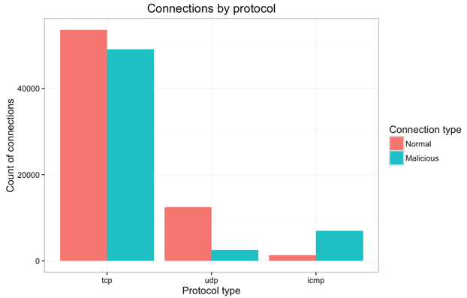
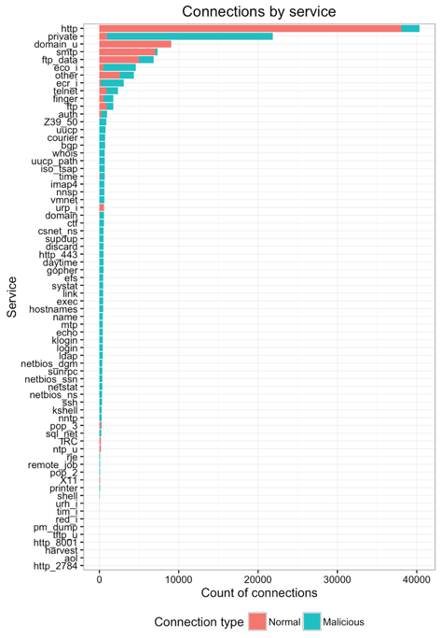
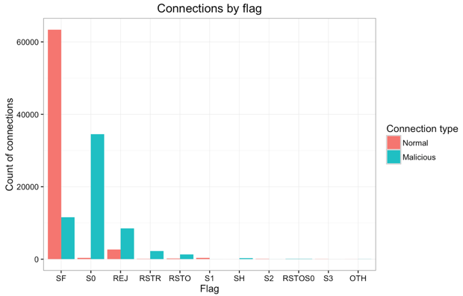
Initial data exploration

Slide 7
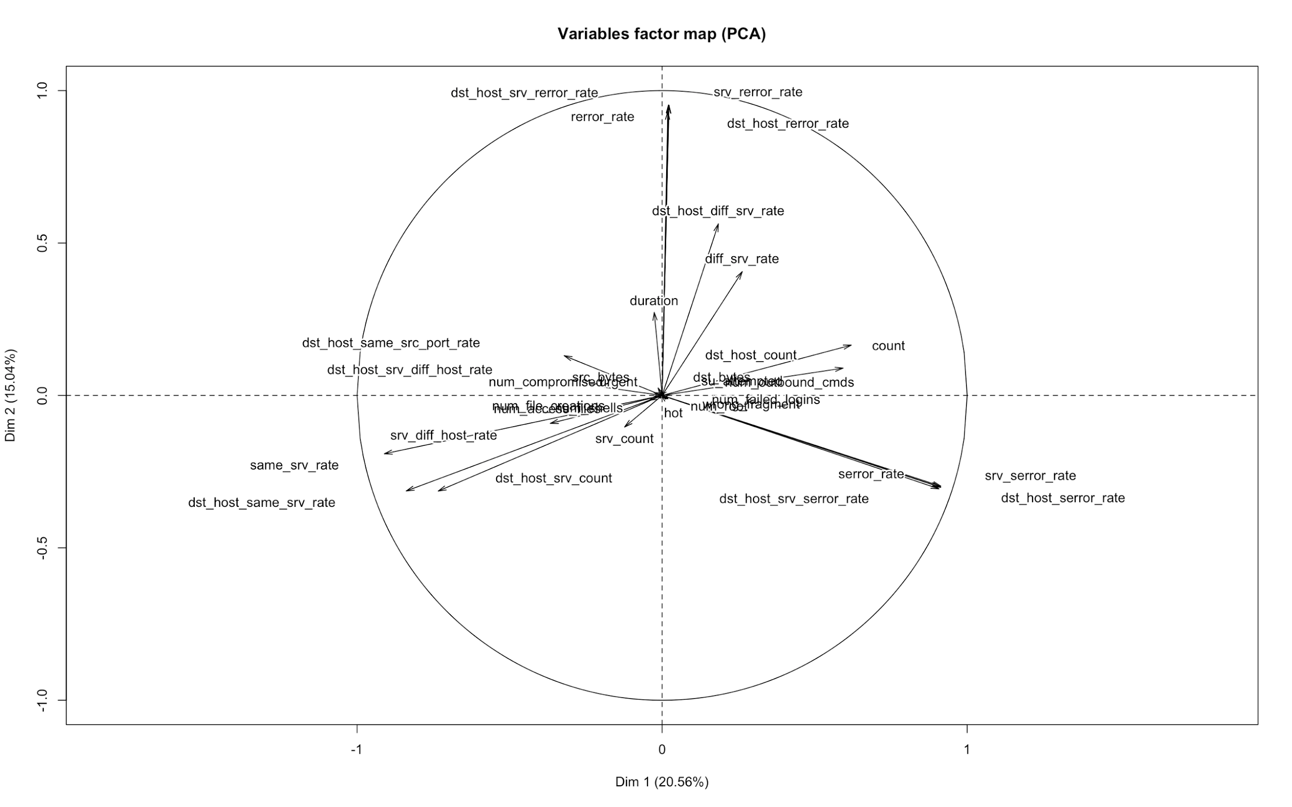
PCA on continuous variables
REJ TCP errors
Connections to different services for same hosts
Count of connections for same hosts
Connections to same services for same hosts
SYN TCP errors
Notes:
Call out that same_srv_rate and diff_srv_rate should be complementary but aren’t

Slide 8
Predictive Modeling

Slide 9
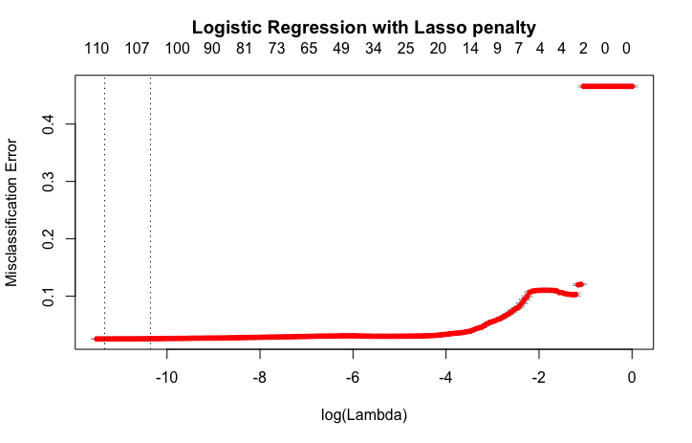
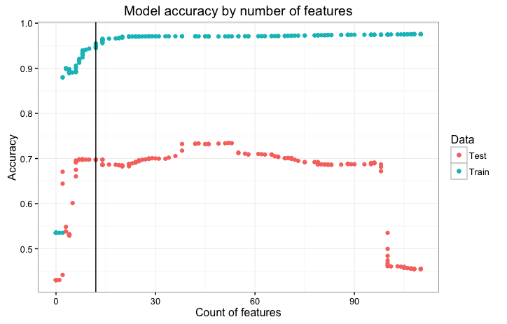
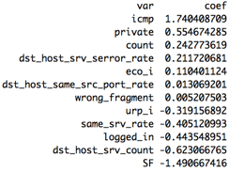
Logistic Regression with Lasso penalty
Split Train 70%/30% then 10-fold CV for lambda:
Balance accuracy and complexity:
12
-3
12
Retained features and coefficients:
Model performance:
69.78% accuracy in test vs 94.48% in train!
48.35% true positive rate
1.89% false positive rate
Why such a large discrepancy in train vs test accuracy?

Slide 10
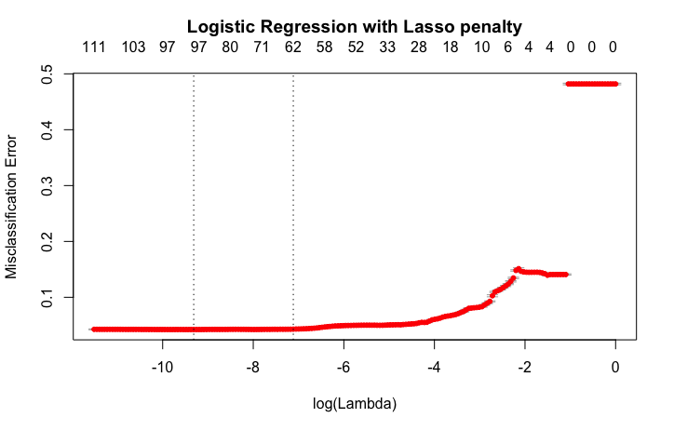
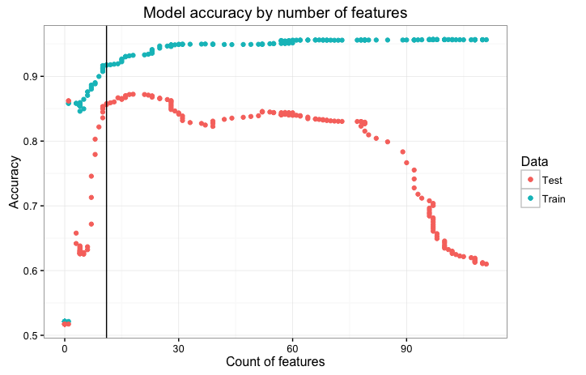
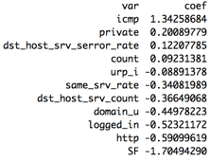
Logistic Regression with Lasso penalty - Shuffled
What happens if we combine, resample and re-split Train and Test datasets?
Split Train 70%/30% then 10-fold CV for lambda:
Balance accuracy and complexity:
11
-3
11
Retained features and coefficients:
Model performance:
85.63% accuracy in test vs 91.72% in train!
72.83% true positive rate
2.43% false positive rate
Is there underlying bias in the test data?

Slide 11
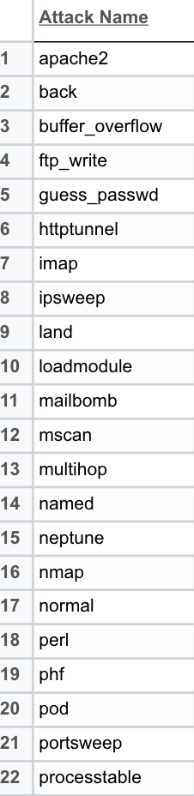
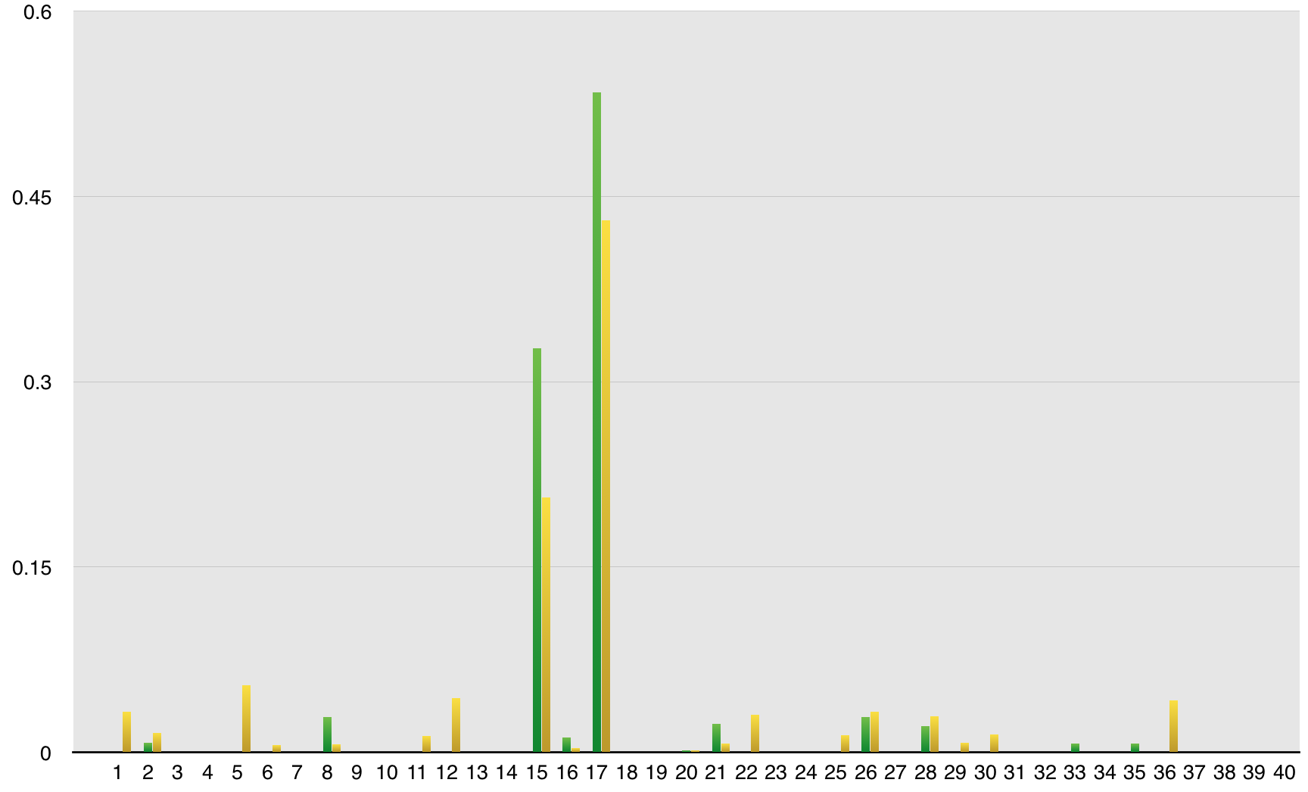
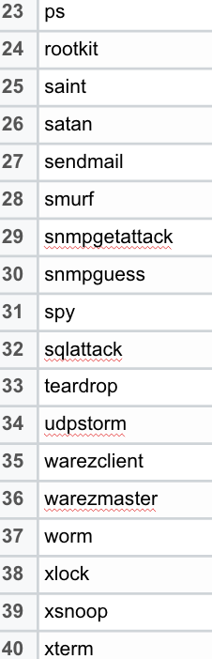
Train vs Test Data
The distribution of attacks differs between train and test
2 attacks in train are not in test
17 attacks in test are not in train
Including new attack types in test that aren’t in train is more realistic
Attack Distribution (Train vs. Test)
Train
Test
Percentage of Dataset
Attack #
Notes:
Graph with both training and test attack type breakdown
E.g. nmap drastically different between training/test. Training 1493, Test 73;

Slide 12
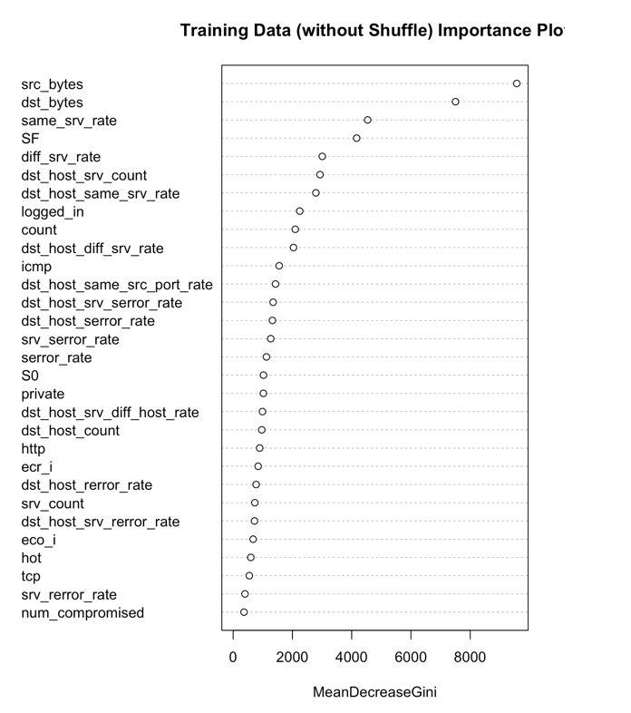
Random Forest
Unshuffled Train and Test data:
Parameters:
mtry: 15
# of trees: 500
Accuracy:
Train OOB error: 0.001
Test accuracy: 77.21%
True positive rate: 61.97%
False positive rate: 2.66%

Slide 13
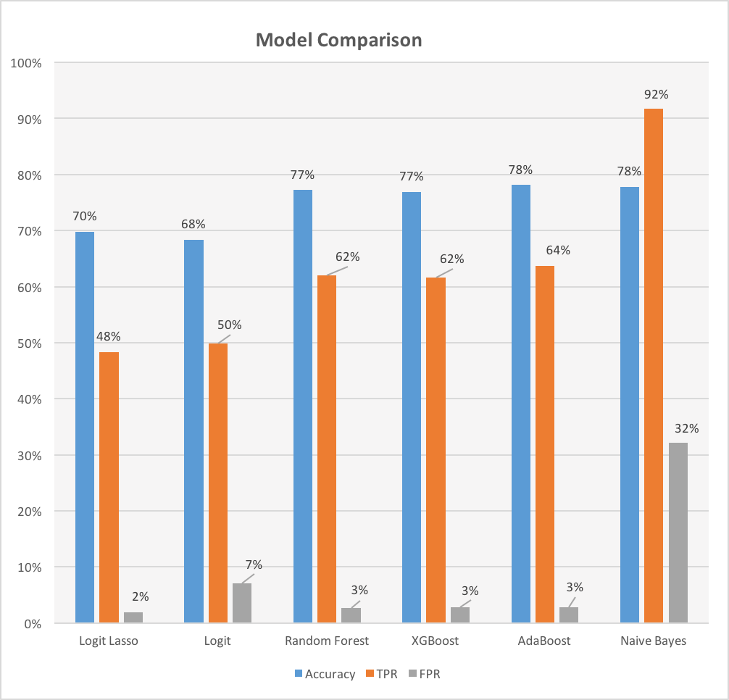
Model Comparison
Parameters:
Xgboost:
eta = 0.02
max_depth = 5
Adaboost:
nu = 1
iter = 50
Naive Bayes:
10-fold CV
Laplace = 1
Note:
TPR: True Positive Rate (higher is better)
FPR: False Positive Rate (lower is better)

Slide 14
How can we further improve network intrusion detection?

Slide 15
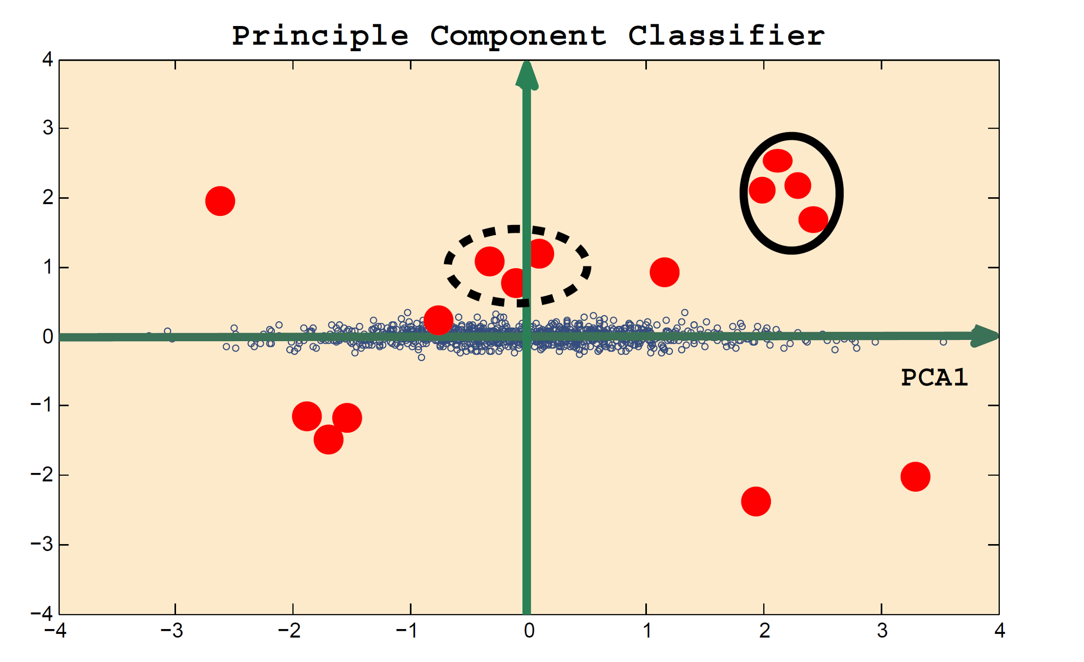
Principal Component Classifier (supervised learning)
Principal Component Classifier
X1
Classified as “abnormal” if
PCA2
X2
or
else classified as “normal”
Ref.: A Novel Anomaly Detection Scheme Based on Principal Component Classifier
NRL Release Number 03-1221.1-2312
Authors: Mei-Ling Shyu, Shu-Ching Chen, Kanoksri Sarinnapakorn, and LiWu Chang

Slide 16
Principal Component Classifier Results
On original features:
Accuracy: 80%
True positive rate: 92%
False positive rate: 29%
After adding predicted probabilities from logistic regression:
Accuracy: 83%
True positive rate: 92%
False positive rate: 13%

Slide 17
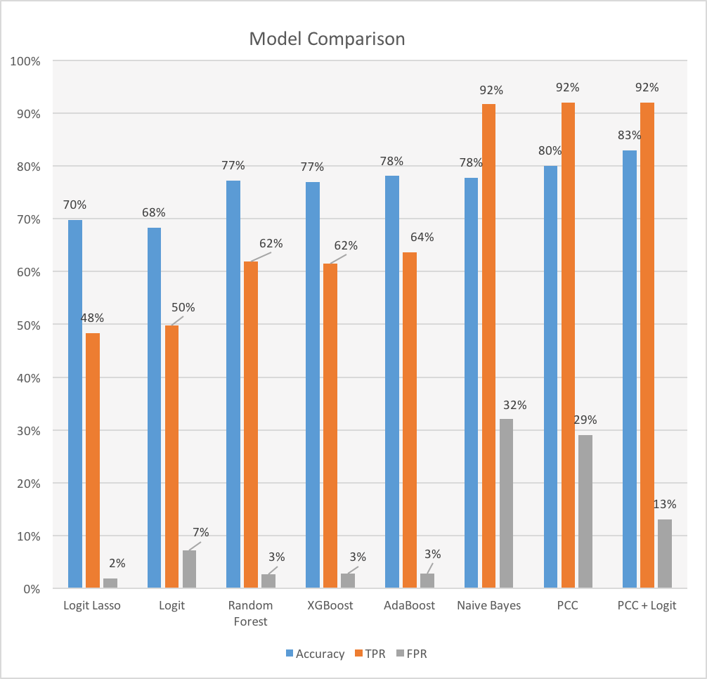
Final Model Comparison
Note:
TPR: True Positive Rate (higher is better)
FPR: False Positive Rate (lower is better)

Slide 18
Conclusion
Shuffling training and test datasets is a flawed approach since unknown attacks are routinely encountered in real-world scenarios.
Basic PCC and naive Bayes models outperform others used in this analysis when new attack patterns are not present in the training dataset.
Further development of PCC and naive Bayes models could lead to even better model performance for anomaly detection, as well as fine tuning of other algorithms and more advanced stacking / ensembling.

Slide 19
Appendices

Slide 20
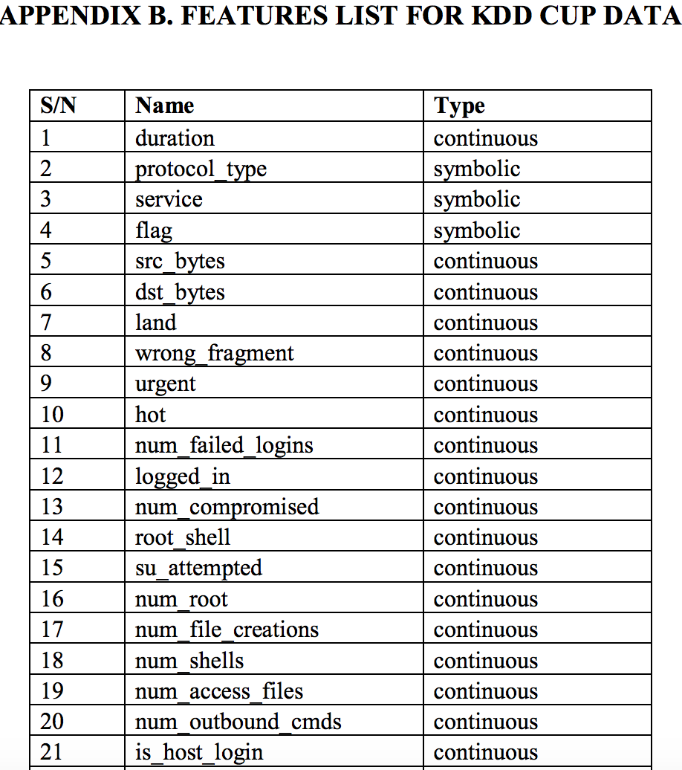
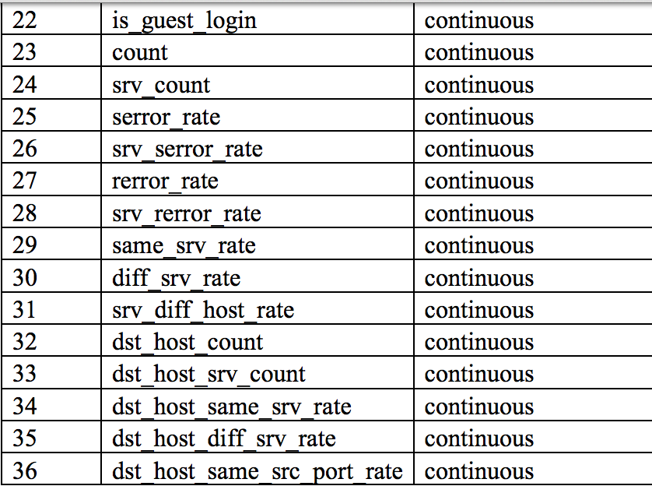
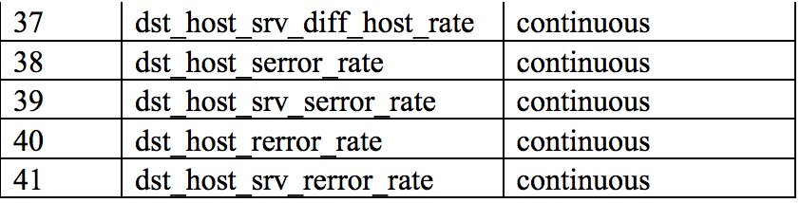
Appendix - List of features

Slide 21
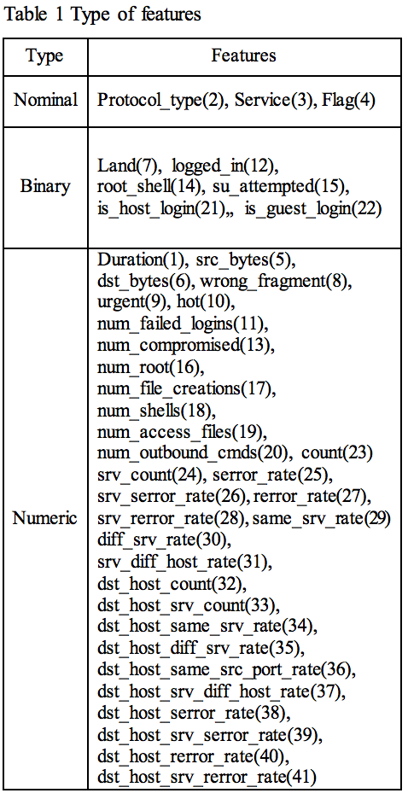
Appendix - Type of features

Slide 22
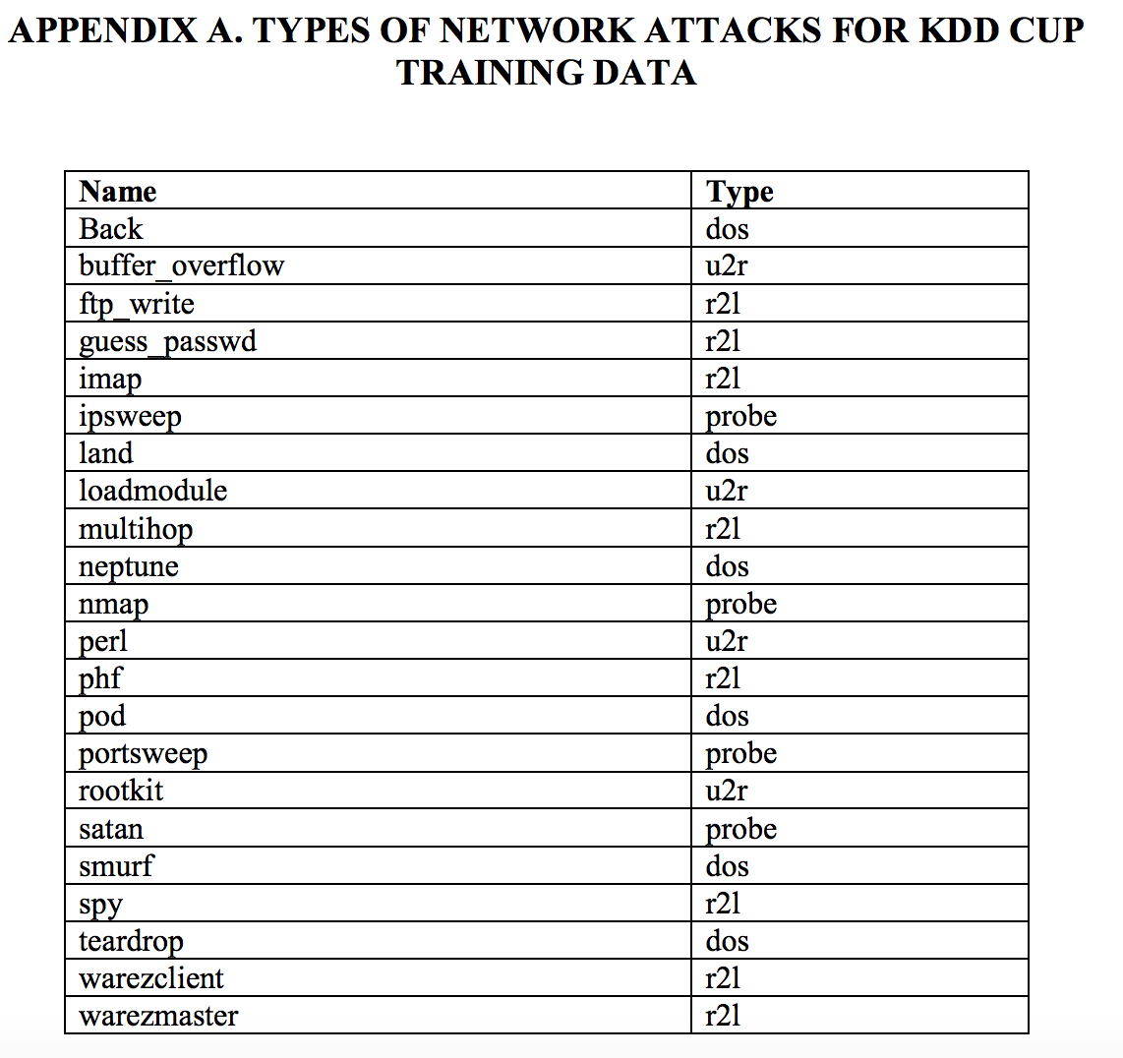
Appendix - Network attack types

Slide 23
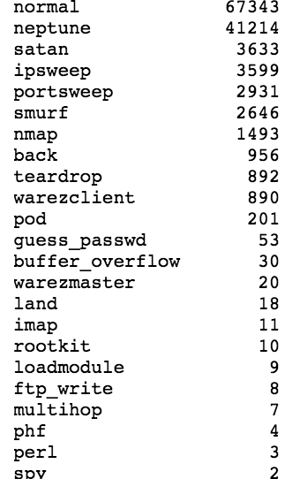
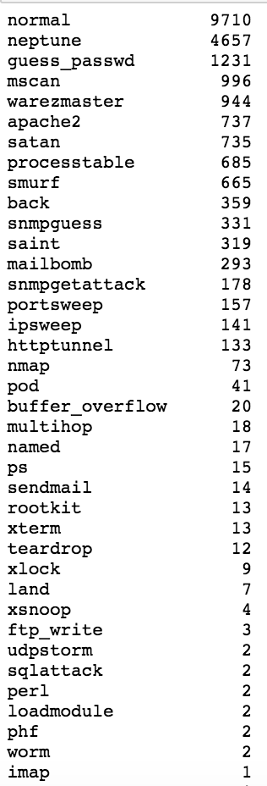
Appendix - Training vs test attack types
Training
Test

Slide 24
Appendix – K-Means scree plot

Slide 25
Appendix – K-Means clustering

Slide 26
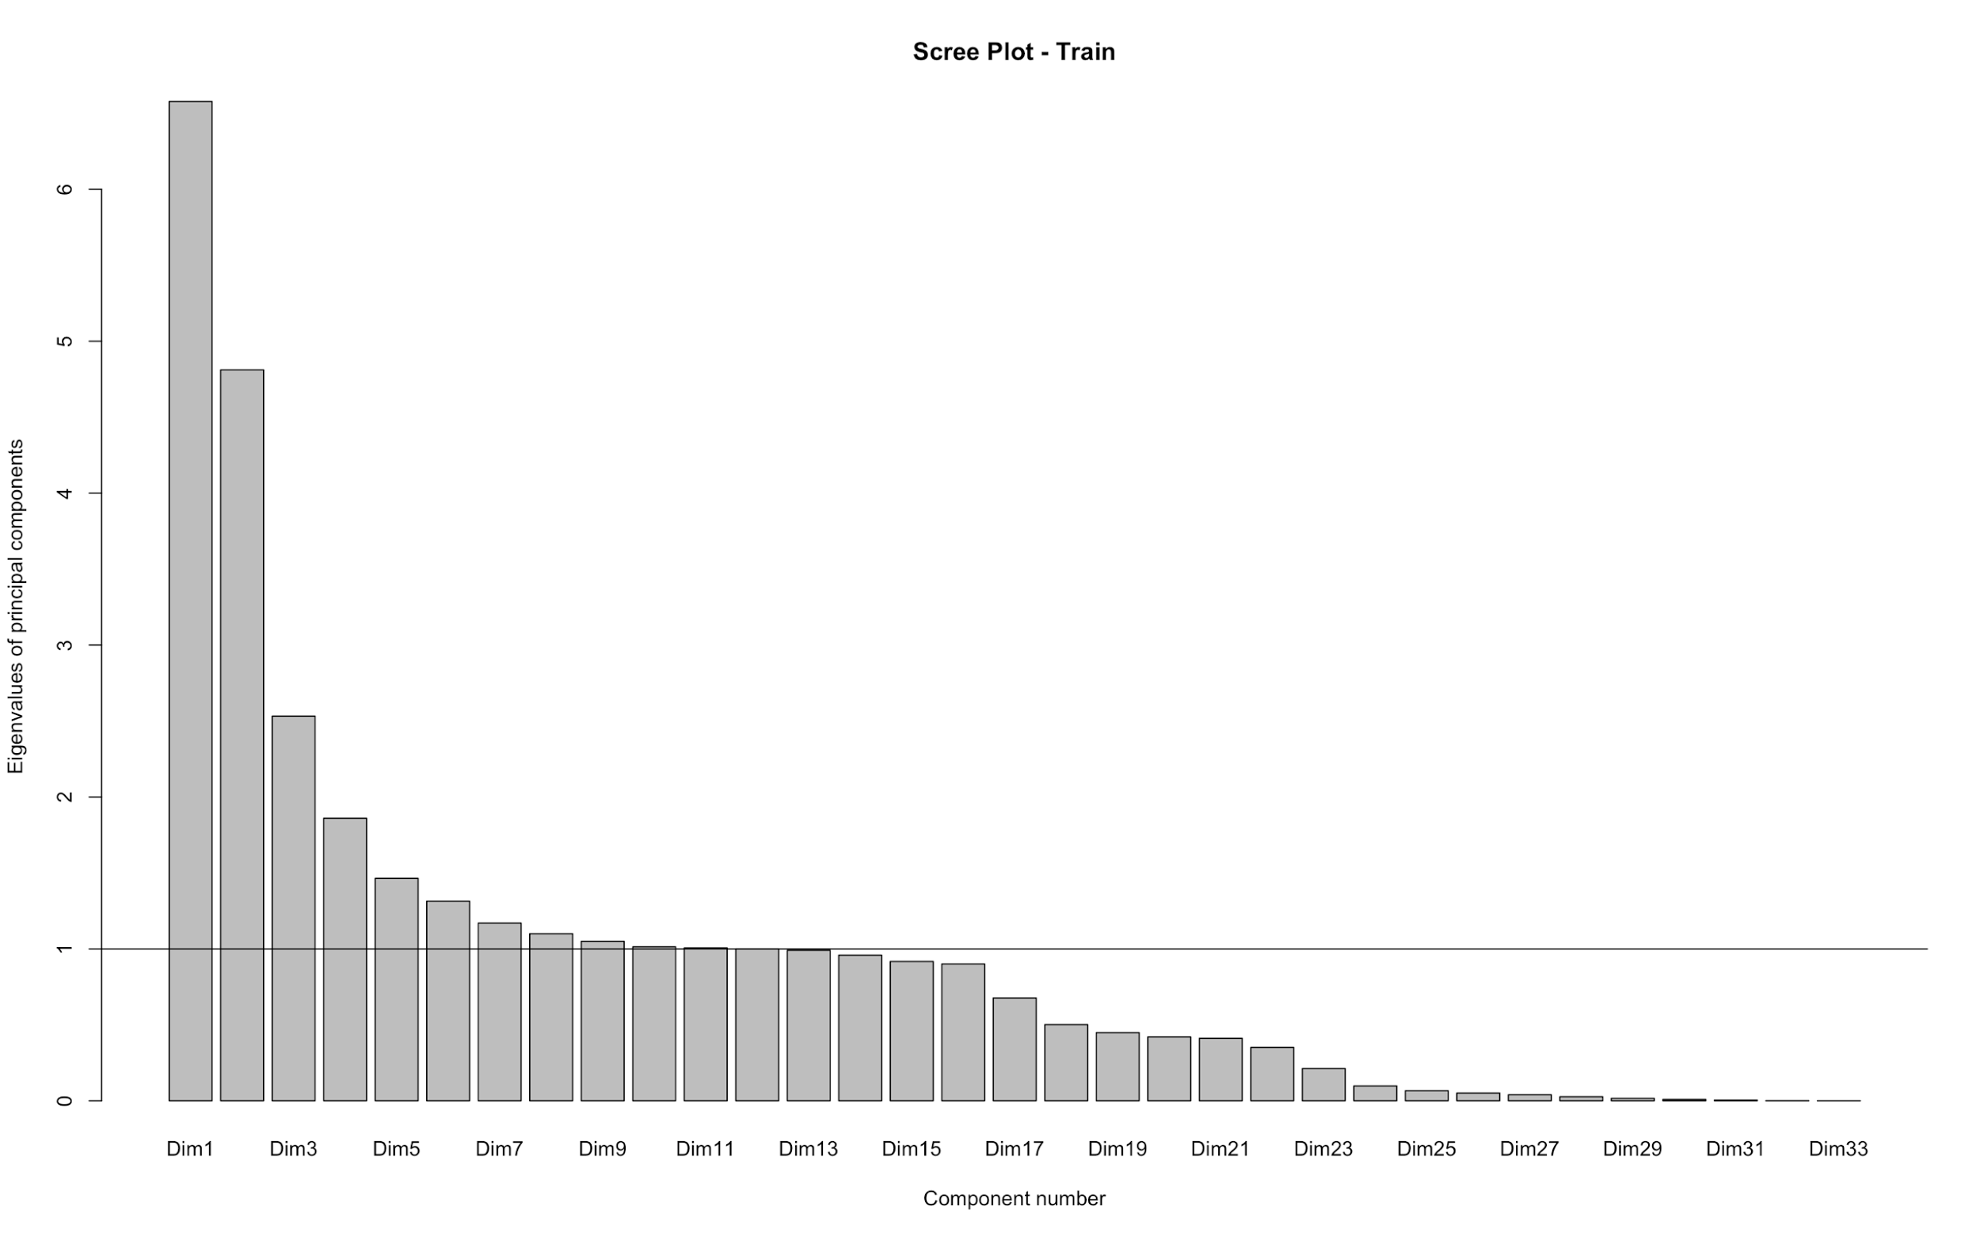
Appendix - PCA eigenvectors
We conducted Principal Component Analysis on the continuous variables in the training dataset:

Slide 27
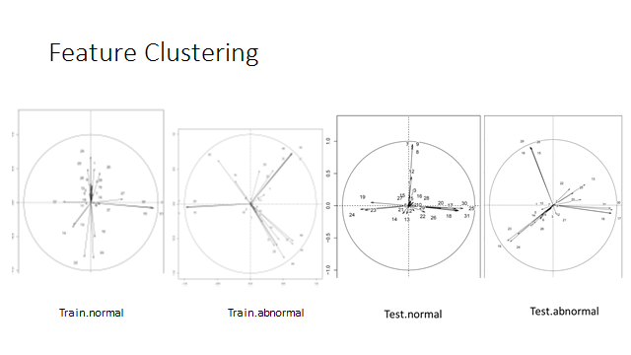
Appendix - PCC feature clustering

Slide 28
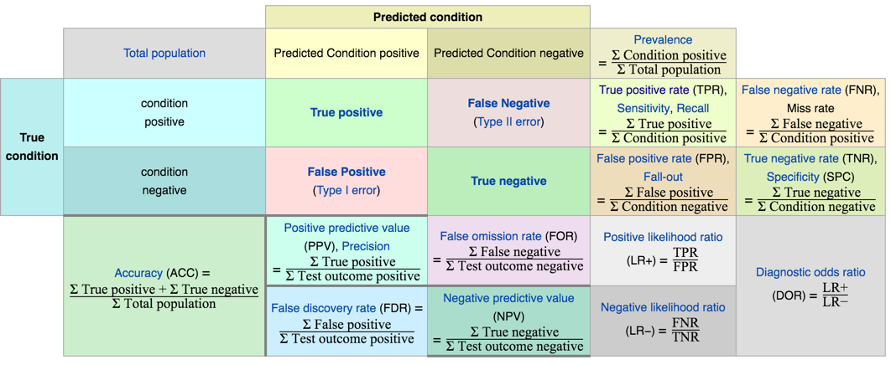
Appendix - Confusion matrix reference
From Source.

Slide 29
Appendix – Other references
TCP: http://ita.ee.lbl.gov/html/contrib/tcp-reduce-doc.html
Feature description: https://kdd.ics.uci.edu/databases/kddcup99/task.html

